Slide 1


Stock Trading & Investment Performance Analytics System
HOME
ABOUT
CONCLUSION
CONTACT
- Rayapudi Rithika

Slide 2

Project Overview
This project focuses on building an automated analytics system for stock market and portfolio data
The system processes raw stock prices and trading transactions into analytics-ready insights
Emphasis is placed on:
Data quality and consistency
Automated workflow execution
Scalable analytics
Business-oriented visualization
The solution mirrors real-world financial analytics pipelines used in industry

Slide 3

Problem Context
HOME
Stock market data is time-series based and sensitive to missing or irregular trading days
Manual analysis is not scalable and often inconsistent
Portfolio data is usually fragmented across multiple files
There is a need for:
Automated processing
Reliable return and risk calculations
A consolidated analytical view

Slide 4

Data Scope Used
Daily stock price data for:
AAPL, MSFT, GOOGL
Attributes processed:
Open, High, Low, Close, Volume
Simulated portfolio transaction data:
Buy and Sell trades
Quantity and trade price
Data handled entirely using structured CSV-based workflows

Slide 5
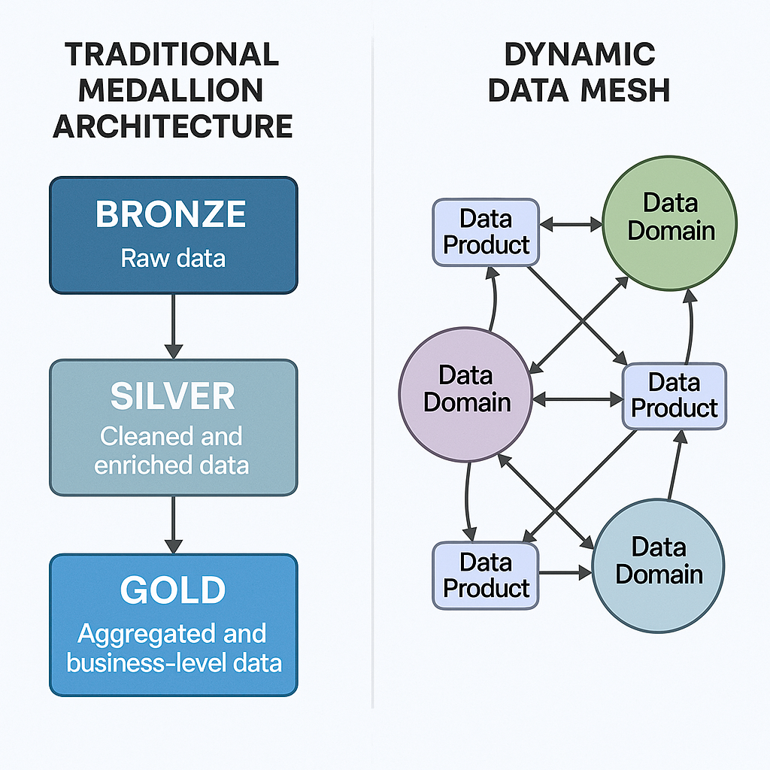
Pipeline Architectcure
Data quality
The solution follows the Medallion Architecture:
Bronze: Raw data ingestion
Silver: Cleaning and standardization
Gold: Aggregated analytics
Apache Airflow orchestrates the execution of all layers
Azure Databricks is used for scalable analytics processing
Power BI consumes gold-layer outputs for visualization

Slide 6
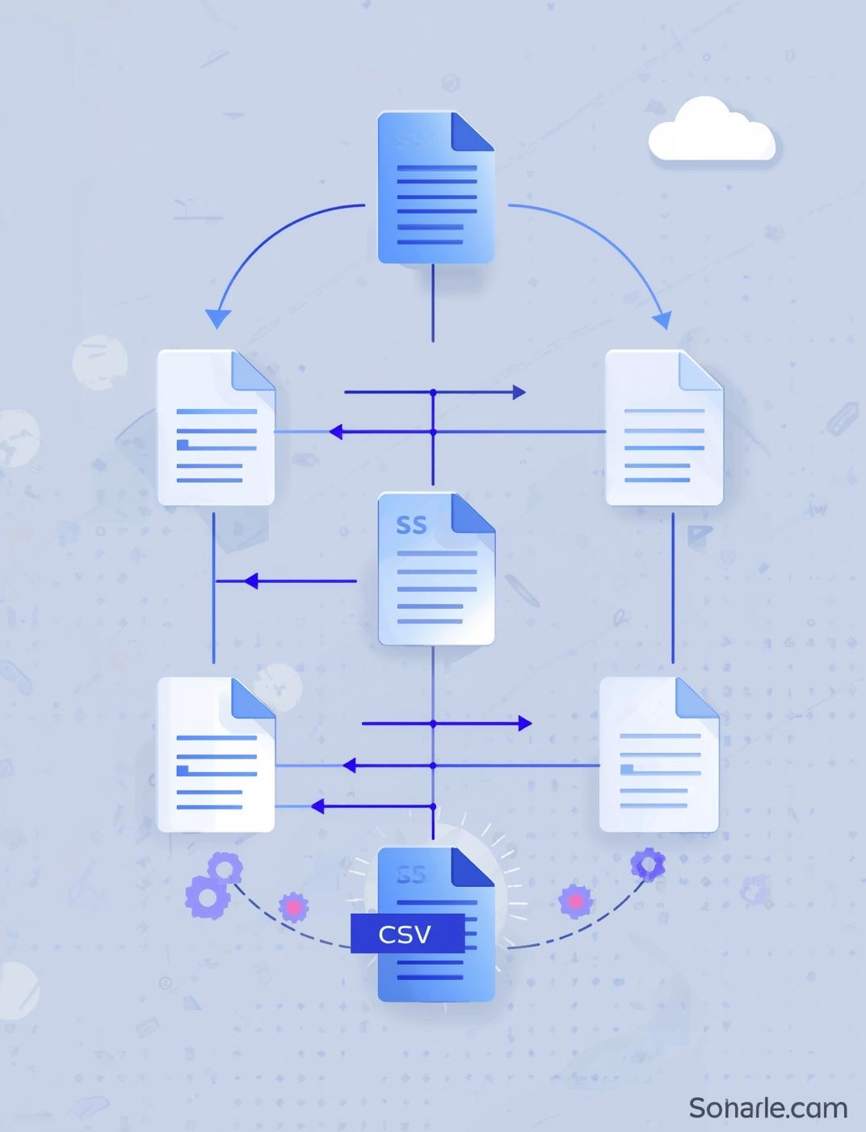
Bronze Layer: Data Ingestion
Raw stock CSV files are loaded using Python
Individual stock datasets are tagged with identifiers
Multiple stock files are combined into a unified dataset
Ingested data is written to processed storage as CSV outputs
No analytical transformations are applied at this stage

Slide 7
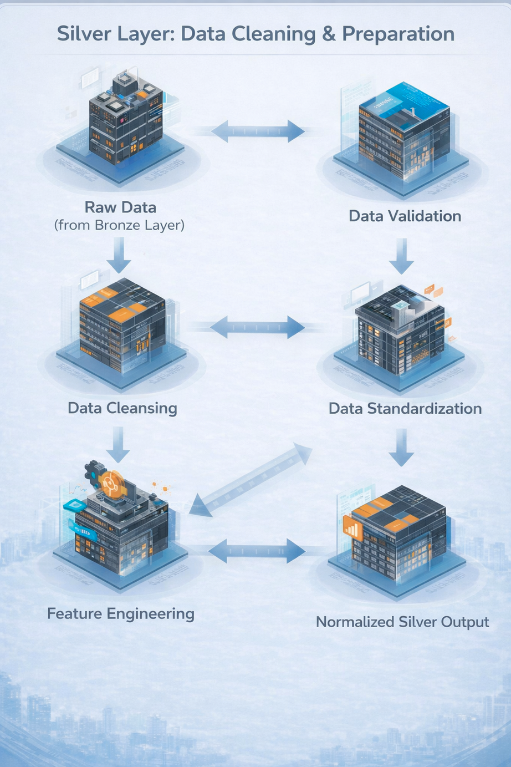
Silver Layer: Data Cleaning & Preparation
CONTACT
Missing values in price and volume columns are handled
Data is sorted by stock and trading date
Time-series continuity is maintained
Derived metrics are computed:
Daily return
Cumulative return
Moving averages
Price normalization is applied for cross-stock comparison

Slide 8
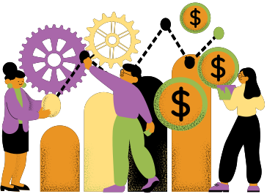
Portfolio Transaction Processing
Raw transaction data is ingested using Python
Invalid records are removed based on:
Missing trade dates
Invalid quantities or prices
Incorrect trade types
Cleaned transaction data is prepared for portfolio analytics
Ensures accurate downstream investment analysis

Slide 9
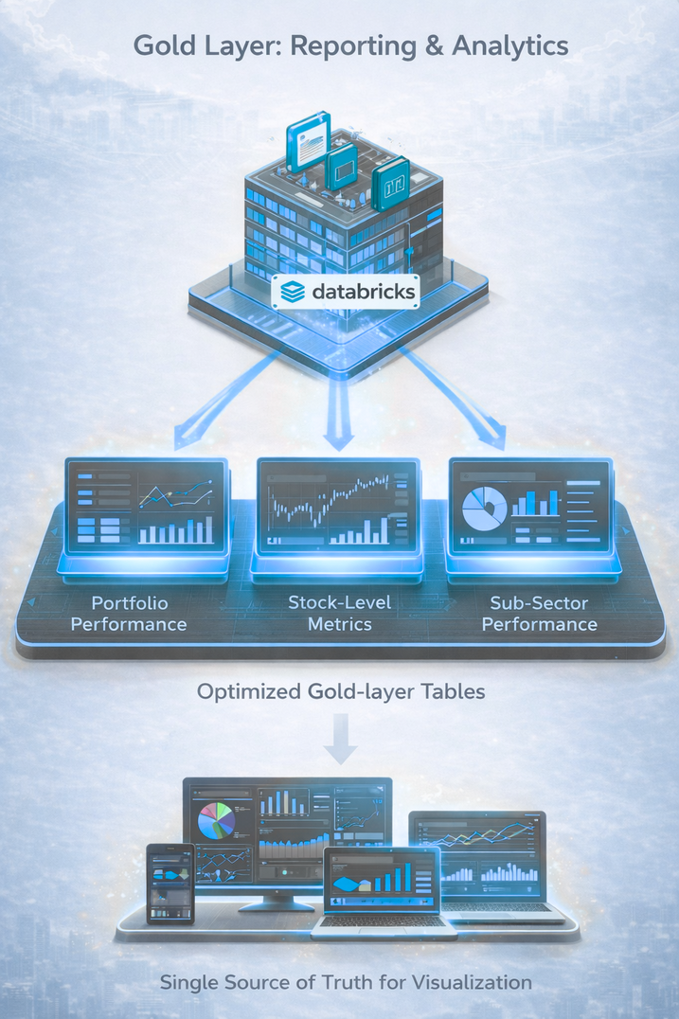
Gold Layer:
Analytical Processing
CONTACT
Databricks notebooks are used for analytical transformations
Aggregations and summaries are generated for:
Portfolio performance
Stock-level metrics
Sub-sector performance
Gold-layer tables are optimized for reporting and dashboards
Outputs serve as a single source of truth for visualization

Slide 10
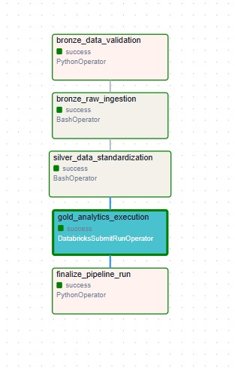
Workflow Automation & Monitoring
Apache Airflow DAG orchestrates the entire pipeline
Tasks include:
Bronze ingestion
Silver transformation
Gold analytics execution
Airflow provides:
Scheduling
Dependency management
Retries and failure handling
Execution logs for monitoring

Slide 11

Visualization & Reporting
Power BI dashboards are built on gold-layer datasets
Dashboards provide insights into:
Stock trends and returns
Portfolio allocation and performance
Trading activity
Risk and market indicators
Visuals are designed for clarity and business interpretation

Slide 12
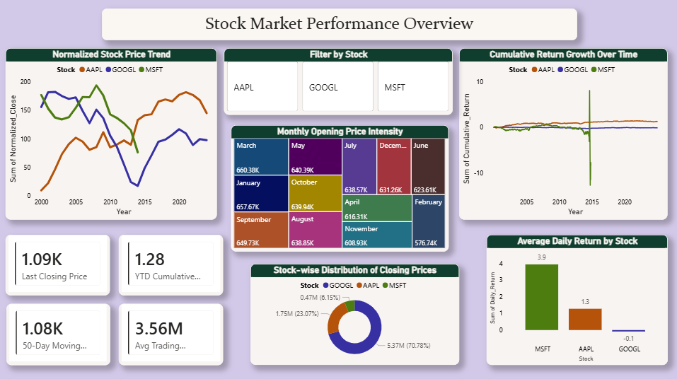
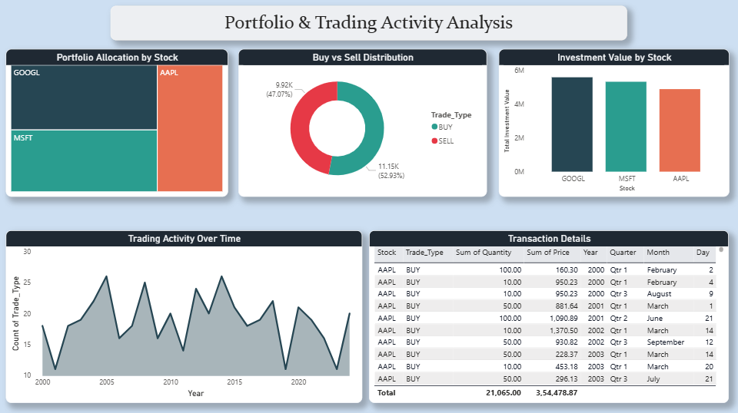
Dashboards
Stock Market Performance Overview
Provides a consolidated view of stock price trends, cumulative returns, and trading activity across selected stocks to understand overall market behaviour.
Portfolio & Trading Activity Analysis
Analyzes portfolio allocation, buy vs sell distribution, and trading frequency to evaluate investment behavior and transaction patterns.

Slide 13
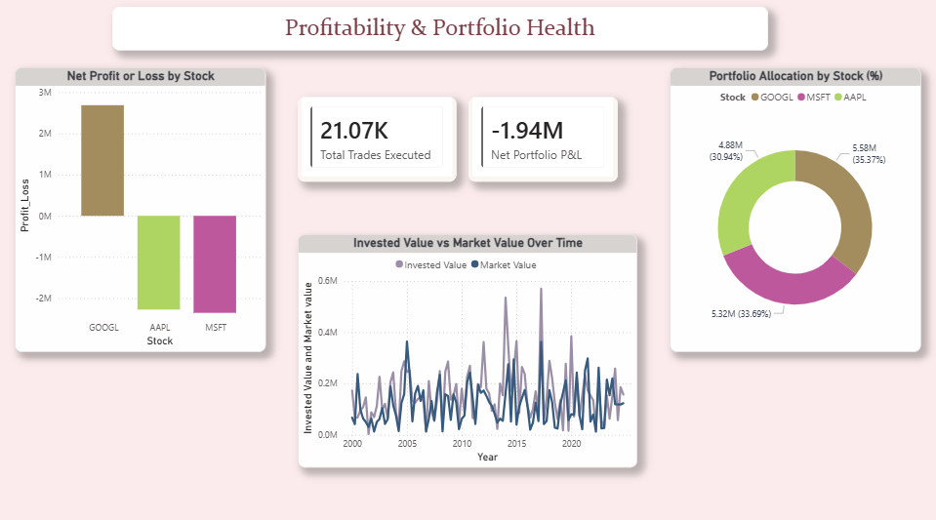
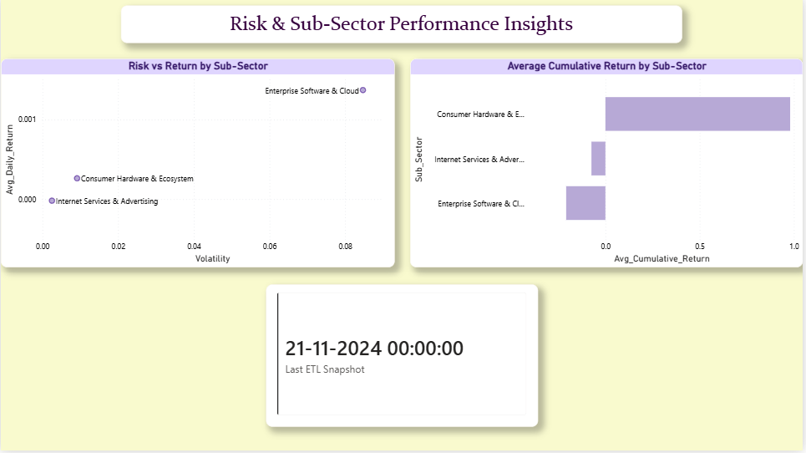
Dashboards
Profitability & Portfolio Health
Highlights portfolio profit or loss, invested versus market value trends, and overall portfolio health across stocks.
Risk & Sub-Sector Performance Insights
Compares risk, return, and cumulative performance across sub-sectors to identify stable and high-risk investment areas

Slide 14

Outcomes & Key Learnings
Built a complete automated stock analytics pipeline
Applied real-world data engineering practices
Gained experience with:
Pandas time-series analysis
PySpark-based analytics
Workflow orchestration using Airflow
Business-focused dashboarding
The project reflects enterprise-grade analytics workflows

Slide 15
Thank you

